Slide 1
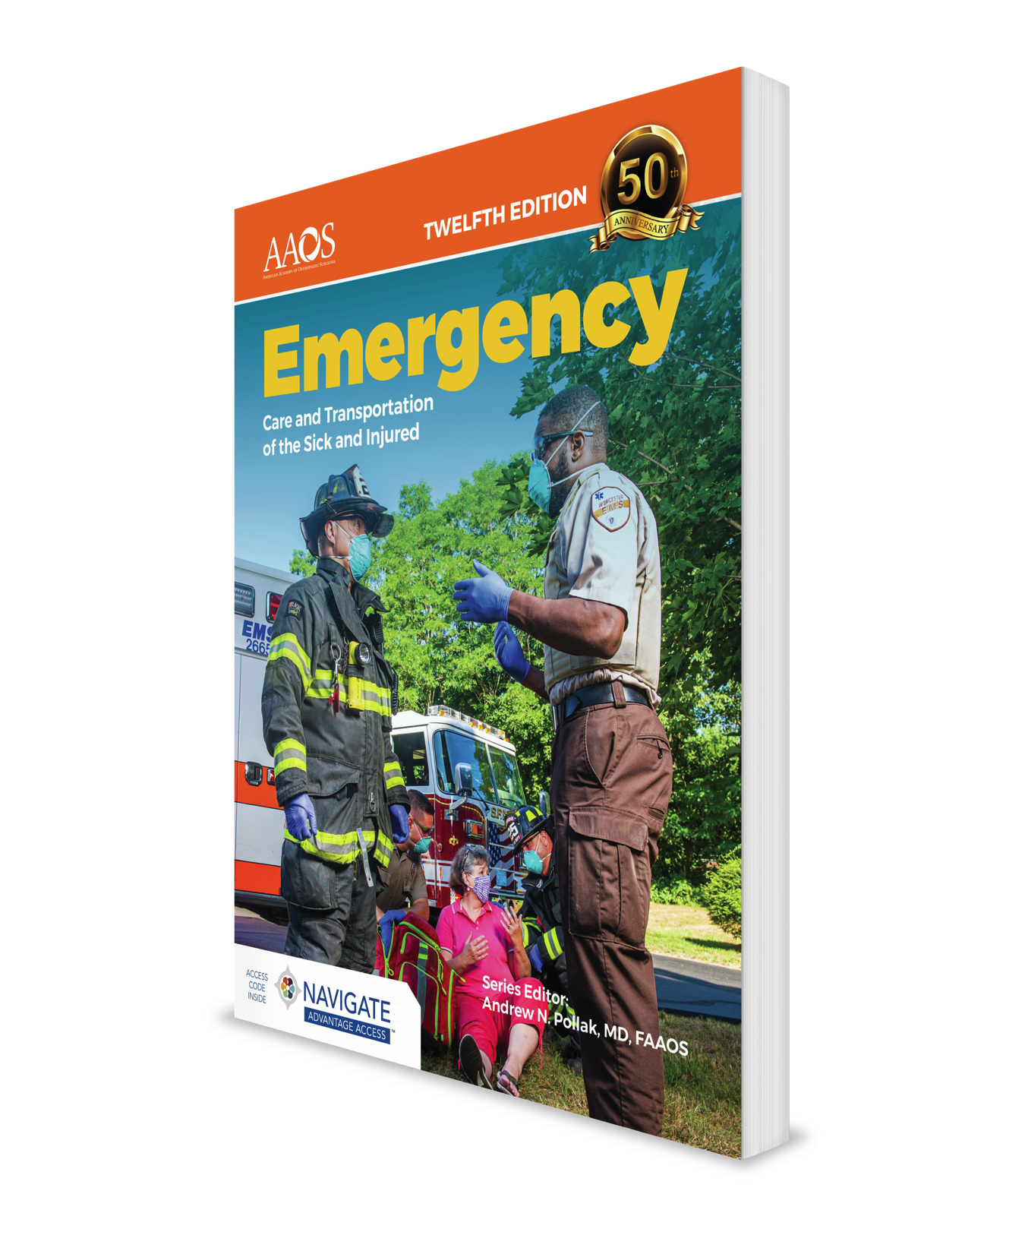
Gastrointestinal and Urologic Emergencies
CHAPTER 19

Slide 2
National EMS Education Standard Competencies (1 of 4)
Medicine
Applies fundamental knowledge to provide basic emergency care and transportation based on assessment findings for an acutely ill patient.
Notes:
National EMS Education Standard Competencies
Medicine
Applies fundamental knowledge to provide basic emergency care and transportation based on assessment findings for an acutely ill patient.

Slide 3
National EMS Education Standard Competencies (2 of 4)
Abdominal and Gastrointestinal Disorders
  Anatomy, presentations, and management of shock associated with abdominal emergencies
    Gastrointestinal bleeding
Notes:
National EMS Education Standard Competencies
Abdominal and Gastrointestinal Disorders
Anatomy, presentations, and management of shock associated with abdominal emergencies
• Gastrointestinal bleeding

Slide 4
National EMS Education Standard Competencies (3 of 4)
Abdominal and Gastrointestinal Disorders (cont’d)
  Anatomy, physiology, pathophysiology, assessment, and management of
    Acute and chronic gastrointestinal hemorrhage
    Peritonitis
    Ulcerative diseases
Notes:
National EMS Education Standard Competencies
Anatomy, physiology, pathophysiology, assessment, and management of
• Acute and chronic gastrointestinal hemorrhage
• Peritonitis
• Ulcerative diseases

Slide 5
National EMS Education Standard Competencies (4 of 4)
Genitourinary/Renal
  Blood pressure assessment in hemodialysis patients
  Anatomy, physiology, pathophysiology, assessment, and management of
    Complications related to
      Renal dialysis
      Urinary catheter management (not insertion)
    Kidney stones
Notes:
National EMS Education Standard Competencies
Genitourinary/Renal
• Blood pressure assessment in hemodialysis patients
Anatomy, physiology, pathophysiology, assessment, and management of
complications related to:
Renal dialysis
Urinary catheter management (not insertion)
• Kidney stones

Slide 6
Introduction
Abdominal pain is a common complaint.
  Cause of abdominal pain is often difficult to determine.
As an EMT:
  You do not need to determine the exact cause.
  You should be able to recognize a life-threatening problem and act.
Notes:
Lecture Outline
I. Introduction
A. Abdominal pain is a common complaint.
1. The cause of abdominal pain is often difficult to identify.
B. As an EMT:
1. You do not need to determine the exact cause of abdominal pain.
2. You should be able to recognize a life-threatening problem and act swiftly in response.
3. The patient in pain is probably anxious, requiring application of your skills of rapid assessment and emotional support.

Slide 7
Anatomy and Physiology (1 of 3)
Abdominal cavity contains:
  Gastrointestinal system
  Genital system
  Urinary system
Made up of solid and hollow organs
Notes:
Lecture Outline
II. Anatomy and Physiology
A. Abdominal cavity
1. Contains solid and hollow organs that make up three systems:
a. Gastrointestinal system
b. Genital system
c. Urinary system

Slide 8
Anatomy and Physiology (2 of 3)
Injury to a solid organ can cause shock and bleeding.
Breach of a hollow organ causes its contents to leak and contaminate the abdominal cavity.
Notes:
Lecture Outline
Injury to a solid organ can cause shock and bleeding.
If perforation of hollow organs occurs, the contents will leak and contaminate the abdominal cavity.

Slide 9
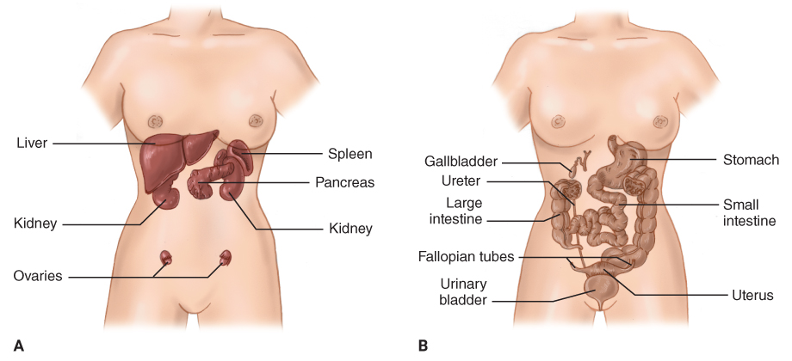
Anatomy and Physiology (3 of 3)
FIGURE 19-1 The solid and hollow organs of the abdomen. A. Solid organs include the liver, spleen, pancreas, kidneys, and ovaries (in women). B. Hollow organs include the gallbladder, stomach, small intestine, large intestine, and bladder.
A, B: © Jones & Bartlett Learning.
Notes:
The illustration on the left shows the hollow organs of the abdomen. The illustration on the right shows the solid organs of the abdomen.

Slide 10
The Gastrointestinal System (1 of 6)
Responsible for digestion process
Digestion begins when food is chewed.
The stomach is the main digestive organ.
  Gastric juices break food down.
Notes:
Lecture Outline
B. Gastrointestinal system
1. Responsible for digestion process
2. Digestion begins when food is put into the mouth and chewed.
3. The stomach is the main organ of the digestive system.
a. Gastric juices break down food.

Slide 11
The Gastrointestinal System (2 of 6)
The liver assists in digestion.
  Secretes bile and aids in digestion of fats
  Filters toxic substances
  Creates glucose stores
The gallbladder is a reservoir for bile.
Notes:
Lecture Outline
4. The liver assists in digestion.
a. Secretes bile
b. Filters toxic substances produced by digestion
c. Creates glucose stores
d. Produces substances necessary for blood clotting and immune function
5. The gallbladder is a reservoir for bile.

Slide 12
The Gastrointestinal System (3 of 6)
Small intestine
  Duodenum
    Digestive juices from pancreas and liver mix.
    Pancreas releases amylase, bicarbonate, and insulin.
  Jejunum
    Absorbs digestive products
    Does most of the work
Notes:
Lecture Outline
6. Food then travels to the small intestine, which consists of three sections:
a. Duodenum
i. Digestive juices from the pancreas and liver mix together.
ii. The pancreas secretes enzymes that break down starches, fats, and proteins.
b. Jejunum
i. Plays a major role in absorption of digestive products
ii. Does much of the work in the small intestine

Slide 13
The Gastrointestinal System (4 of 6)
Small intestine (cont’d)
  Ileum
    Absorbs nutrients that were not absorbed earlier
    Absorbs bile acids so they can be returned to the liver for future use and vitamin B₁₂ for making nerve cells and red blood cells
Notes:
Lecture Outline
c. Ileum
i. Absorbs nutrients that were not absorbed earlier
ii. Absorbs bile acids so they can be returned to the liver for future use and vitamin B₁₂ for making nerve cells and red blood cells

Slide 14
The Gastrointestinal System (5 of 6)
Colon (large intestine)
  Food that is not broken down comes here.
  Water is absorbed.
  Stool is formed.
Notes:
Lecture Outline
7. Colon (large intestine)
a. Food not broken down and used moves into the colon as a waste product.
b. Water is absorbed and stool is formed.

Slide 15
The Gastrointestinal System (6 of 6)
Spleen
  Located in abdomen
  No digestive function
Notes:
Lecture Outline
8. The spleen is located in the abdomen but has no digestive function.

Slide 16
The Genital System (1 of 2)
Male reproductive system:
  Testicles
  Epididymis
  Vasa deferentia
  Seminal vesicles
  Prostate gland
  Penis
Notes:
Lecture Outline
C. Genital system
1. The abdominal space also holds reproductive organs.
2. Male reproductive system:
a. Testicles
b. Epididymis
c. Vasa deferentia
d. Seminal vesicles
e. Prostate gland
f. Penis

Slide 17
The Genital System (2 of 2)
Female reproductive system:
  Ovaries
  Fallopian tubes
  Uterus
  Cervix
  Vagina
Notes:
Lecture Outline
3. Female reproductive system:
a. Ovaries
b. Fallopian tubes
c. Uterus
d. Cervix
e. Vagina

Slide 18
The Urinary System (1 of 3)
Controls discharge of waste materials filtered from blood by kidneys
The kidneys are solid organs.
There are two kidneys, one on each side of the body.
Notes:
Lecture Outline
D. Urinary system
1. Controls discharge of certain waste materials filtered from blood by the kidneys
2. The kidneys are solid organs, and the ureters, bladder, and urethra are hollow organs.
3. There are two kidneys, one on each side.

Slide 19
The Urinary System (2 of 3)
Ureters join each kidney to the bladder.
The bladder is located behind the pubic symphysis.
The bladder empties urine outside body through the urethra.
  1.5 to 2 L of urine per day
Notes:
Lecture Outline
4. Ureters join each kidney to the bladder.
5. The urinary bladder is located immediately behind the pubic symphysis.
6. The bladder empties to the outside of the body through the urethra.
7. Normal adult forms 1.5 to 2 L of urine per day.

Slide 20
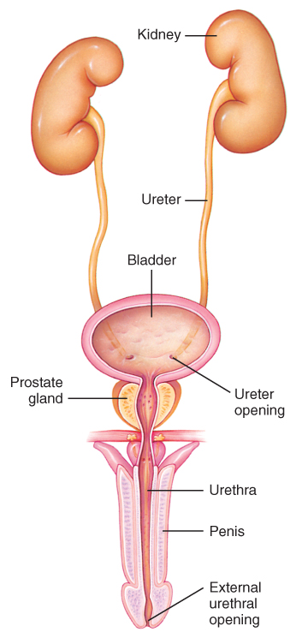
The Urinary System (3 of 3)
FIGURE 19-2 The urinary system lies in the retroperitoneal space behind the organs of the digestive system. The urinary system in men and women includes the kidneys, ureters, bladder, and urethra. This diagram shows the male urinary system.
© Jones & Bartlett Learning.
Notes:
The illustration on this slide displays the male urinary system.

Slide 21
Pathophysiology (1 of 4)
The abdominal cavity is lined by the peritoneum.
  Parietal peritoneum lines the walls of the abdominal cavity.
  Visceral peritoneum covers organs.
Foreign material such as blood, pus, or bile can irritate the peritoneum.
  Causes peritonitis
Notes:
Lecture Outline
III. Pathophysiology
A. The abdominal cavity is lined by a membrane called the peritoneum.
1. The peritoneum also covers the organs of the abdomen.
a. The parietal peritoneum lines the walls of the abdominal cavity.
b. The visceral peritoneum covers the organs.
2. The presence of foreign material (blood, pus, bile, pancreatic juice, amniotic fluid) can irritate the peritoneum, causing peritonitis.

Slide 22
Pathophysiology (2 of 4)
“Acute abdomen” refers to the sudden onset of abdominal pain.
  Often associated with severe, progressive problems
Notes:
Lecture Outline
B. Acute abdomen refers to the sudden onset of abdominal pain.
1. Often associated with severe, progressive problems requiring medical attention

Slide 23
Pathophysiology (3 of 4)
Peritonitis
  Inflammation of peritoneum
  Typically causes ileus
Ileus
  Paralysis of muscular contractions
  Retained gas and feces cause distention.
  Stomach empties by emesis.
Notes:
Lecture Outline
Peritonitis
1. Can cause ileus, which is paralysis of muscular contractions that normally propel material through the intestine
a. Retained gas and feces causes distention.
b. Stomach empties by emesis.

Slide 24
Pathophysiology (4 of 4)
Diverticulitis
  Inflammation of small pockets at weak areas in the muscle walls
Cholecystitis
  Inflammation of the gallbladder
Acute appendicitis
Notes:
Lecture Outline
2. Diverticulitis
a. Inflammation in small pockets at weak areas in the muscle walls
3. Cholecystitis
a. Gallbladder inflammation
4. Acute appendicitis

Slide 25
Abdominal Pain
Two types of nerves supply the peritoneum.
Parietal peritoneum: supplied by the same nerves that supply the skin of the abdomen
Visceral peritoneum: supplied by the autonomic nervous system
Notes:
Lecture Outline
D. Abdominal pain
1. Two different types of nerves supply the peritoneum.
a. Parietal peritoneum: supplied by the same nerves that supply the skin of the abdomen.
i. Can easily identify and localize a point of irritation
b. Visceral peritoneum is supplied by the autonomic nervous system.
i. Nerves less able to identify and localize pain.
2. Referred pain
a. Results from the connection between the body’s two separate nervous systems.

Slide 26
Causes of Acute Abdomen (1 of 7)
Ulcers
  Protective layer of mucus erodes, allowing acid to eat into the organ
  May lead to gastric bleeding and peritonitis
Notes:
Lecture Outline
E. Common causes of acute abdomen
1. Ulcers: protective layer of the mucous lining erodes, allowing acid to eat into the organ
a. Common causes
i. Most peptic ulcers are caused by an infection of the stomach with Heliobacter pylori bacteria.
ii. Chronic use of anti-inflammatory drugs (NSAIDs)
b. Signs and symptoms
i. Gnawing pain in the stomach
ii. Nausea, vomiting, belching, and heartburn.
c. Complications
i. Hematemesis
ii. Melena
iii. Peritonitis

Slide 27
Causes of Acute Abdomen (2 of 7)
Gallstones
  Gallstones may form and block its outlet.
    Cause pain
    Lead to cholecystitis
Notes:
Lecture Outline
Gallstones
a. May form and block the outlet from the gallbladder
b. If the blockage is not relieved, inflammation of the gallbladder (cholecystitis) can occur.
c. Signs and symptoms
i. Constant, severe pain in the right upper or midabdominal region that may refer to the right upper back, shoulder area, or flank.
ii. Nausea, vomiting, indigestion, bloating, gas, and belching.

Slide 28
Causes of Acute Abdomen (3 of 7)
Pancreatitis
  Inflammation of the pancreas
  Caused by obstructing gallstone, alcohol abuse, or other diseases
  Signs and symptoms include pain in upper left and right quadrants, nausea, vomiting, and abdominal distention.
  Sepsis or hemorrhage may occur.
Notes:
Lecture Outline
3. Pancreatitis
a. Common causes
i. An obstructing gallstone
ii. Alcohol abuse
b. Signs and symptoms
i. Severe pain in the upper left and right quadrants that can radiate to the back.
ii. Nausea, vomiting, abdominal distention, and tenderness.
c. Complications
i. Sepsis or hemorrhage

Slide 29
Causes of Acute Abdomen (4 of 7)
Appendicitis
  Inflammation or infection in the appendix
  Nausea, vomiting, anorexia, fever, chills, rebound tenderness
Gastrointestinal hemorrhage
  Bleeding within gastrointestinal tract
  May be acute or chronic
Notes:
Lecture Outline
4. Appendicitis: inflammation or infection in the appendix
a. Signs and symptoms
i. Initial pain that is generalized, dull, and diffuse, which may center in the umbilical area.
ii. Pain later localizes to the right lower quadrant.
iii. May have referred pain.
iv. Nausea, vomiting, anorexia, fever, and chills.
v. Rebound tenderness
b. Complications
i. Abscess
ii. Peritonitis
iii. Shock
5. Gastrointestinal hemorrhage
a. Symptom of another disease, not a disease itself
b. May be acute or chronic
c. Can occur in upper or lower gastrointestinal tract
d. Common causes
i. Upper GI tract: esophagitis, esophageal varices, or Mallory-Weiss tear.
ii. Lower GI tract: Inflammation, diverticulosis, diverticulitis, cancer, and hemorrhoids.
e. Signs and symptoms
i. Upper GI tract: Hematemesis and melena
ii. Lower Gi tract: Bright red stools

Slide 30
Causes of Acute Abdomen (5 of 7)
Esophagitis
  Lining of the esophagus becomes inflamed by infection or acids from the stomach.
  Pain in swallowing, heartburn, nausea, vomiting, sores in mouth
Esophageal varices
  Capillary network in the esophagus leaks.
  Fatigue, weight loss, jaundice, anorexia, edema, abdominal pain
Notes:
Lecture Outline
6. Esophagitis
a. Occurs when the lining of the esophagus becomes inflamed by infection or acids from the stomach
b. Gastroesophageal reflux disease (GERD)
c. Signs and symptoms
i. Pain with swallowing and feeling like there is something stuck in his or her throat.
ii. Heartburn, nausea, vomiting, and sores in the mouth.
7. Esophageal varices
a. Amount of pressure within blood vessels surrounding the esophagus increases, frequently as a result of liver failure.
b. Common causes
i. alcohol in industrialized countries
ii. viral hepatitis in developing countries
c. With a gradual disease process, patients will initially shows signs of liver disease.
d. Rupture of varices is far more sudden.
i. Signs and symptoms: sudden onset discomfort in the epigastric region or sternum; difficulty swallowing, vomiting of bright red blood, hypotension, and signs of shock.
ii. Complications: significant blood loss

Slide 31
Causes of Acute Abdomen (6 of 7)
Mallory-Weiss syndrome
  Junction between esophagus and stomach tears.
  Principal symptom: vomiting
Gastroenteritis
  Infection from bacterial or viral organisms or caused by noninfectious conditions
  Principal symptom: diarrhea
Notes:
Lecture Outline
8. Mallory-Weiss syndrome: junction between the esophagus and the stomach tears
a. Common causes
i. violent coughing or vomiting
b. Signs and symptoms
i. signs of shock, upper abdominal pain, hematemesis, and melena.
9. Gastroenteritis
a. Infection combined with diarrhea, nausea, and vomiting
b. Can also be caused by noninfectious conditions
c. Signs and symptoms: diarrhea, with blood and/or pus, abdominal cramping, nausea, vomiting, fever, and anorexia.
d. Complications: dehydration and shock.

Slide 32
Causes of Acute Abdomen (7 of 7)
Diverticulitis
  Fecal matter becomes caught in colon walls, causing inflammation and infection.
  Fever, malaise, body aches, chills
Hemorrhoids
  Created by swelling and inflammation of blood vessels surrounding rectum
  Bright red blood during defecation
Notes:
Lecture Outline
10. Diverticulitis
a. Lack of fiber in the diet causes the consistency of stools became more solid, requiring more intestinal contractions and increasing pressure in the colon.
b. Bulges in the colonic walls result from increased intestinal contractions.
i. Fecal matter becomes caught in the bulges, allowing bacteria to collect, and resulting in inflammation and infection.
c. Signs and symptoms
i. Abdominal pain localized more in the left lower quadrant.
d. Complications
i. Perforation of the intestinal wall leading to severe infection and shock.
11. Hemorrhoids: created by swelling and inflammation of blood vessels surrounding rectum
a. Common causes
i. Conditions that increase pressure on the rectum or irritation of the rectum.
b. Signs and symptoms
i. Painless, bright red bleeding during defecation.

Slide 33
Urinary System
Cystitis (bladder infection) is common.
  Also called urinary tract infection (UTI)
  Caused by bacterial infection
  Becomes serious if infection spreads to kidneys
  Reports of urgency and frequency of urination
Notes:
Lecture Outline
F. Urinary system
1. Cystitis (bladder inflammation)
a. Also called urinary tract infection (UTI)
b. Common cause
i. Bacterial infection
c. Signs and symptoms
i. Midline lower abdominal pain
ii. Blood in the urine, an urgency and frequency in urination, and pressure and pain around the bladder.
d. Complications
i. Kidney infection

Slide 34
Kidneys (1 of 2)
Play a major role in maintaining homeostasis
When the kidneys fail, uremia results.
Kidney stones can grow over time and cause blockage.
Notes:
Lecture Outline
Kidneys
1. Play a major role in maintaining homeostasis
2. When the kidneys fail, uremia results.
3. Kidney stones can grow over time and cause blockage.

Slide 35
Kidneys (2 of 2)
Acute kidney failure
  Sudden decrease in kidney function
  Reversible with prompt diagnosis and treatment
Chronic kidney failure
  Irreversible
  Progressive, develops over months/years
  Eventually dialysis or transplant is required.
Notes:
Lecture Outline
Acute kidney failure
a. Sudden decrease in function
b. Common causes: hemorrhage, dehydration, trauma, shock, sepsis, heart failure, medications, drug abuse, and kidney stones.
c. Reversible with prompt diagnosis and treatment
Chronic kidney failure
a. Progressive and irreversible damage
b. Common causes
i. Diabetes or hypertension
c. Signs and symptoms
i. Lethargy, nausea, headaches, cramps, edema in the extremities and face, seizures and coma.
d. Will eventually require treatment with dialysis
e. These patients have an increased risk of heart failure and cardiac arrest.

Slide 36
Female Reproductive Organs
Gynecologic problems are a common cause of acute abdominal pain.
Lower quadrant pain may relate to the ovaries, fallopian tubes, or uterus.
Notes:
Lecture Outline
H. Female reproductive organs
1. Gynecologic problems are a common cause of acute abdominal pain.
2. Lower quadrant pain may relate to the ovaries, fallopian tubes, or uterus.
3. Chapter 23, “Gynecologic Emergencies,” covers gynecologic emergencies in depth.

Slide 37
Other Organ Systems (1 of 3)
The aorta lies immediately behind the peritoneum.
  Weak areas can result in abdominal aortic aneurysm (AAA).
    AAA is difficult to detect.
    Use extreme caution when assessing or detecting AAA.
Notes:
Lecture Outline
I. Other organ systems
1. The aorta lies immediately behind the peritoneum.
a. Weak areas can result in abdominal aortic aneurysm (AAA).
i. AAA is difficult to detect.
ii. Back pain with a tearing sensation
iii. Use extreme caution when trying to assess or detect AAA.
iv. If the aneurysm tears or ruptures, massive hemorrhage may occur.

Slide 38
Other Organ Systems (2 of 3)
Hernias
  Protrusion of an organ or tissue through an opening into a body cavity where it does not belong
  May not always produce noticeable mass or lump
  Strangulation is a serious medical emergency.
Notes:
Lecture Outline
2. Hernia
a. Protrusion of an organ or tissue through a hole or opening into a body cavity where it does not belong
i. Common causes: congenital defects, a surgical wound that has failed to heal, a natural weakness in an area such as the groin.
b. Hernias may not always produce a noticeable mass or lump.
c. Reducible hernias pose little risk and can be pushed back into the body cavity.
d. Incarcerated hernias cannot be pushed back in and are compressed by surrounding body tissue.
e. Strangulation of an incarcerated hernia is a serious medical emergency.
i. Blood supply is compromised by the compressed surrounding tissue.

Slide 39
Other Organ Systems (3 of 3)
Serious hernia signs and symptoms:
  A formerly reducible mass that is no longer reducible
  Pain at the hernia site
  Tenderness when the hernia is palpated
  Red or blue skin discoloration
Notes:
Lecture Outline
f. Serious hernia signs and symptoms:
i. A formerly reducible mass that is no longer reducible
ii. Pain at the hernia site
iii. Tenderness when the hernia is palpated
iv. Red or blue skin discoloration over the hernia

Slide 40
Scene Size-up
Scene safety and standard precautions
Mechanism of injury/nature of illness
  May be the result of violence
  Use assessment results to develop an early index of suspicion for life threats.
Notes:
Lecture Outline
IV. Patient Assessment
A. Scene size-up
1. Scene safety and standard precautions
2. Mechanism of injury/nature of illness
a. Acute abdomen can be the result of violence, such as blunt or penetrating trauma.
b. Use assessment results to develop an early index of suspicion for life threats.

Slide 41
Primary Assessment
Airway and breathing
  May cause shallow, inadequate respirations
Circulation
  Ask about blood in vomit or black, tarry stools.
  Check pulses in both feet.
Transport decision
  Immediate transport is needed if there are signs of significant illness.
Notes:
Lecture Outline
B. Primary assessment
1. The first priority to identify and treat life-threatening conditions.
2. Form a general impression.
3. Airway and breathing
a. May present with shallow or inadequate respirations due to pain
4. Circulation
a. Assess for major bleeding.
b. Ask the patient about blood in vomit or black, tarry stools.
c. Pulse rate, quality, and skin condition may indicate shock.
d. Check pulses in both feet.
i. A difference in pulse strength may indicate an aortic dissection.
5. Transport decision
a. Immediate transport is warranted if there are signs of significant illness.

Slide 42
History Taking
SAMPLE history
  Nausea and vomiting
  Change in bowel habits and urination
  Weight loss
  Belching or flatulence
  Pain
  Concurrent chest pain
  Other signs or symptoms
Notes:
Lecture Outline
C. History taking
1. SAMPLE history:
a. Nausea and vomiting
b. Changes in bowel habits
c. Urination
d. Weight loss
e. Belching or flatulence
f. Pain
g. Other signs or symptoms
h. Concurrent chest plain

Slide 43
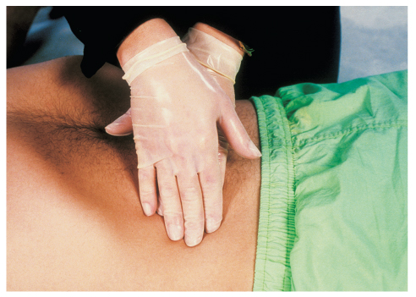
Secondary Assessment (1 of 2)
Physical examination
  Normal abdomen is soft and not tender.
  Pain/tenderness: signs of acute abdomen
  Expose and assess abdomen.
  Palpate gently.
FIGURE 19-4 Check for tenderness or rigidity by gently palpating the abdomen.
© Jones & Bartlett Learning.
Notes:
Lecture Outline
D. Secondary assessment
1. Positioning of the patient may give clues to the nature of illness.
2. Physical examination
a. The normal abdomen is soft and not tender to the touch.
b. Pain and tenderness are the most common symptoms of an acute abdomen.
i. Localized pain may give clues to the problem organ.
ii. Muscles of the abdominal wall may become rigid involuntarily (guarding).

Slide 44
Secondary Assessment (2 of 2)
Vital signs
  Check respiratory rate and pulse rate.
  Avoid taking a blood pressure in the same arm where a dialysis shunt is.
Notes:
Lecture Outline
3. Vital signs
a. A high respiratory rate with a normal pulse rate and blood pressure may indicate improper ventilations.
b. A high respiratory rate and pulse rate with signs of shock may indicate septic or hypovolemic shock.
c. If a patient has a dialysis shunt in his or her arm, avoid taking a blood pressure in the same arm as the shunt to avoid damaging it.

Slide 45
Reassessment
Frequent reassessment is important.
Assess interventions, including treatment for shock and emotional support.
Transport the patient in the most comfortable position.
Notes:
Lecture Outline
E. Reassessment
1. Because it is often difficult to determine the cause of abdominal pain, frequent reassessment is important.
2. Assess interventions, including treatment for shock and providing emotional support.
a. Transport in the most comfortable position for the patient.
b. Consider ALS support.
3. Communication and documentation

Slide 46
Emergency Medical Care
You cannot treat causes of acute abdomen.
  Take steps to provide comfort and lessen effects of shock.
    Treat for shock even when obvious signs are not apparent.
    Low-flow oxygen may decrease nausea and anxiety.
Notes:
Lecture Outline
V. Emergency Medical Care
A. Although you cannot treat the causes of acute abdomen, you can take steps to provide comfort and lessen the effects of shock.
1. Treat the patient for shock even when obvious signs of shock are not apparent.
B. Position patients who are vomiting to maintain a patent airway.
1. Contain the vomitus to prevent spread of infections (use a biohazard bag).
C. Wear gloves, eye protection, a gown, and a mask.
D. When the patient has been released to hospital staff, clean the ambulance and equipment.
E. Wash your hands even though you were wearing gloves.
F. Providing low-flow oxygen may decrease nausea and anxiety.

Slide 47
Dialysis Emergencies (1 of 3)
Dialysis is the only definitive treatment for chronic kidney failure.
  Dialysis filters blood, cleans it of toxins, and returns it to body.
  If the patient misses dialysis treatment, pulmonary edema can occur.
Some services transport patients to and from dialysis centers.
Notes:
Lecture Outline
VI. Dialysis Emergencies
A. In patients with end-stage renal disease or chronic renal failure, dialysis is the only definitive treatment.
1. Dialysis filters the blood, cleanses it of toxins, and returns it to the body.
2. If a patient misses a dialysis treatment, weakness and pulmonary edema can be the first in a series of conditions that become progressively more serious.
3. Some services transport patients to and from dialysis centers.

Slide 48
Dialysis Emergencies (2 of 3)
The dialysis machine functions much like normal kidneys.
Adverse effects of dialysis:
  Hypotension
  Dysrhythmias
  Muscle cramps
  Nausea and vomiting
  Hemorrhage from access site
  Infection at access site
Notes:
Lecture Outline
4. A dialysis machine functions much like normal kidneys do.
a. Patients undergoing long-term hemodialysis have a shunt that connects a vein and an artery, allowing blood flow from the body to the dialysis machine.
b. Peritoneal dialysis allows large amounts of dialysis fluid to be infused into the abdominal cavity.
i. The fluid stays in the cavity for 1 to 2 hours.
ii. Carries a high risk of peritonitis
5. Adverse effects of dialysis:
a. Hypotension
b. Dysrhythmias
c. Chest pain
d. Muscle cramps
e. Nausea and vomiting
f. Hemorrhage from the access site
g. Infection at the access site

Slide 49
Dialysis Emergencies (3 of 3)
Emergency care:
  Manage XABCs.
  Provide high-flow oxygen if indicated.
  Manage any bleeding from access site.
  Position the patient:
    Upright in cases of pulmonary edema
    Supine if the patient is in shock
  Transport promptly
Notes:
Lecture Outline
6. Management of a dialysis patient:
a. Start with the XABCs.
b. Provide high-flow oxygen if indicated.
c. Manage any bleeding from the access site.
d. Position the patient sitting up in case of pulmonary edema or supine if the patient is in shock.
e. Transport promptly.
7. Some dialysis patients also have urinary catheters.
a. Catheters can often be a site of infection.

Slide 50
Review
The ___________ lies in the retroperitoneal space.
  liver
  pancreas
  stomach
  small intestine

Slide 51
Review
Answer: B
Rationale: The pancreas, kidneys, and ovaries lie in the retroperitoneal space, which is behind the peritoneum, and are often the cause of acute abdominal pain. The liver, stomach, and small intestine are all found within the true (anterior) abdomen.

Slide 52
Review
The ___________ lies in the retroperitoneal space.
  liver
  Rationale: The liver is found in anterior abdomen.
  pancreas
  Rationale: Correct answer
  stomach
  Rationale: The stomach is found in the anterior abdomen.
  small intestine
  Rationale: The small intestine is found in the anterior abdomen.

Slide 53
Review
Which of the following is NOT a solid organ?
  Liver
  Kidney
  Spleen
  Gallbladder

Slide 54
Review
Answer: D
Rationale: The gallbladder is a hollow organ that concentrates and stores bile, which is produced by the liver. Other hollow organs include the stomach and intestines. The liver, spleen, and kidney are all solid organs.

Slide 55
Review
Which of the following is NOT a solid organ?
  Liver
  Rationale: The liver is a solid organ.
  Kidney
  Rationale: The kidney is a solid organ.
  Spleen
  Rationale: The spleen is a solid organ.
  Gallbladder
  Rationale: Correct answer

Slide 56
Review
A 34-year-old woman with a recent history of pelvic inflammatory disease presents with acute severe abdominal pain. Her abdomen is distended and diffusely tender to palpation. Based on your findings thus far, you should suspect:
  peritonitis.
  pancreatitis.
  appendicitis.
  cholecystitis.

Slide 57
Review
Answer: A
Rationale: Peritonitis—an inflammation of the thin membrane that lines the abdominal cavity—typically presents with acute abdominal pain. Causes of peritonitis include infection and blunt or penetrating abdominal trauma. The pain caused by peritonitis is typically diffuse (widespread), whereas appendicitis, pancreatitis, and cholecystitis (inflammation of the gallbladder) typically present with pain that is localized to a particular area.

Slide 58
Review
A 34-year-old woman with a recent history of pelvic inflammatory disease presents with acute severe abdominal pain. Her abdomen is distended and diffusely tender to palpation. Based on your findings thus far, you should suspect:
  peritonitis.
  Rationale: Correct answer
  pancreatitis.
  Rationale: Pancreatitis is usually a localized pain (in one specific area).
  appendicitis.
  Rationale: Appendicitis is usually a localized pain (in one specific area).
  cholecystitis.
  Rationale: Cholecystitis is usually a localized pain (in one specific area).

Slide 59
Review
MOST patients with an acute abdomen present with:
  dyspnea.
  diarrhea.
  hypotension.
  tachycardia.

Slide 60
Review
Answer: D
Rationale: Tachycardia (heart rate > 100 beats/min) is commonly seen in patients with an acute abdomen; it is usually the result of severe pain. Hypotension is not seen in all patients with an acute abdomen; if the patient is hypotensive, you should suspect internal bleeding or a severe infection (sepsis). Many patients with an acute abdomen have increased respirations (tachypnea); however, dyspnea (a feeling of shortness of breath) is not common.

Slide 61
Review
MOST patients with an acute abdomen present with:
  dyspnea.
  Rationale: Some patients may have increased respirations, but they typically do not have difficulty breathing.
  diarrhea.
  Rationale: Diarrhea may be a symptom of some abdominal problems but not in most patients.
  hypotension.
  Rationale: Hypotension is not seen in most patients, and shock should be suspected when it is present.
  tachycardia.
  Rationale: Correct answer

Slide 62
Review
Which of the following signs or symptoms would you be LEAST likely to find in a patient with an acute abdomen?
  Rapid, shallow breathing
  Soft, nondistended abdomen
  Tachycardia and restlessness
  Constipation or diarrhea

Slide 63
Review
Answer: B
Rationale: Signs and symptoms of an acute abdomen include, but are not limited to, rapid and shallow breathing, a tense and distended abdomen, tachycardia, restlessness, and constipation or diarrhea.

Slide 64
Review
Which of the following signs or symptoms would you be LEAST likely to find in a patient with an acute abdomen?
  Rapid, shallow breathing
  Rationale: This is a common sign of an acute abdomen.
  Soft, nondistended abdomen
  Rationale: Correct answer
  Tachycardia and restlessness
  Rationale: These are common signs of an acute abdomen.
  Constipation or diarrhea
  Rationale: These are common signs of an acute abdomen.

Slide 65
Review
A condition in which a person experiences a loss of appetite is called:
  ileus.
  colic.
  emesis.
  anorexia.

Slide 66
Review
Answer: D
Rationale: Anorexia is defined as a loss of appetite. It is a nonspecific symptom but is often associated with gastrointestinal diseases and abdominal pain. Ileus is the paralysis of the muscular contractions that normally propel material through the intestine. Colic is a severe, intermittent cramping pain. Emesis is the proper medical term for vomiting.

Slide 67
Review
A condition in which a person experiences a loss of appetite is called:
  ileus.
  Rationale: Ileus is the paralysis of the muscular contractions that normally propel material through the intestine.
  colic.
  Rationale: Colic is a severe, intermittent cramping pain.
  emesis.
  Rationale: Emesis is also known as vomiting.
  anorexia.
  Rationale: Correct answer

Slide 68
Review
The medical term for inflammation of the urinary bladder is:
  cystitis.
  nephritis.
  cholecystitis.
  diverticulitis.

Slide 69
Review
Answer: A
Rationale: Cystitis is the medical term for inflammation of the urinary bladder. Nephritis is inflammation of the kidney. Cholecystitis is inflammation of the gallbladder. Diverticulitis is a condition in which small pouches in the colon (large intestine) become inflamed.

Slide 70
Review
The medical term for inflammation of the urinary bladder is:
  cystitis.
  Rationale: Correct answer
  nephritis.
  Rationale: Nephritis is the inflammation of the kidney.
  cholecystitis.
  Rationale: Cholecystitis is inflammation of the gallbladder.
  diverticulitis.
  Rationale: Diverticulitis is inflammation of part of the large intestine.

Slide 71
Review
If a hernia is incarcerated and the contents are so greatly compressed that circulation is compromised, the hernia is said to be:
  reducible.
  ruptured.
  strangulated.
  congenital.

Slide 72
Review
Answer: C
Rationale: A strangulated hernia occurs when a hernia is incarcerated and compressed by the surrounding tissues. It is a serious medical emergency and requires immediate surgery to repair the hernia, remove dead tissue, and return oxygen to the tissues. When the mass can be placed back into the body, it is considered reducible. Hernias are not at risk of rupturing. A congenital hernia is one that is present at birth and is usually present around the umbilicus.

Slide 73
Review
If a hernia is incarcerated and the contents are so greatly compressed that circulation is compromised, the hernia is said to be:
  reduced.
  Rationale: This is a mass or lump that will disappear back into the body cavity in which it belongs.
  ruptured.
  Rationale: This is a mass or lump that bursts from internal pressure.
  strangulated.
  Rationale: Correct answer
  hypoxemic.
  Rationale: This is a decrease in arterial oxygen levels.

Slide 74
Review
A 70-year-old man presents with an acute onset of severe, tearing abdominal pain that radiates to his back. His BP is 88/66 mm Hg, pulse rate is 120 beats/min, and respirations are 26 breaths/min. Treatment for this patient should include:
  rapid transport to the hospital.
  firm palpation of the abdomen.
  placing him in a sitting position.
  oxygen at 4 L/min via nasal cannula.

Slide 75
Review
Answer: A
Rationale: Severe, tearing abdominal pain that radiates to the back is typical of an abdominal aortic aneurysm (AAA); it commonly occurs in older patients—especially those with hypertension. Treatment includes high-flow oxygen and rapid transport. If the patient has signs of shock, place him or her supine. Do not vigorously palpate the patient’s abdomen; doing so may cause the aneurysm to rupture.

Slide 76
Review
A 70-year-old man presents with an acute onset of severe, tearing abdominal pain that radiates to his back. His BP is 88/66 mm Hg, pulse rate is 120 beats/min, and respirations are 26 breaths/min. Treatment for this patient should include:
  rapid transport to the hospital.
  Rationale: Correct answer
  firm palpation of the abdomen.
  Rationale: A firm or vigorous palpation is contraindicated in patients with severe and sudden-onset abdominal pain.
  placing him in a sitting position.
  Rationale: Hypotension is treated by elevating the patient’s legs into the shock position.
  oxygen at 4 L/min via nasal cannula.
  Rationale: High-flow oxygen is indicated in the treatment of shock.

Slide 77
Review
In which position do most patients with acute abdominal pain prefer to be transported?
  Sitting, with their head elevated 45°
  Supine, with their legs elevated 12 inches
  On their side, with their knees flexed
  Fowler position, with their legs straight

Slide 78
Review
Answer: C
Rationale: Most patients with acute abdominal pain prefer to lie on their side with their knees flexed (and usually drawn up into their abdomen). This position takes pressure off the abdominal muscles and may afford them pain relief. The other positions do not allow the pressure to be relieved and may cause further discomfort.

Slide 79
Review
In which position do most patients with acute abdominal pain prefer to be transported?
  Sitting, with their head elevated 45°
  Rationale: This is also know as the semi-Fowler position.
  Supine, with their legs elevated 12 inches
  Rationale: This position will not relieve pressure from the abdomen.
  On their side, with their knees flexed
  Rationale: Correct answer
  Fowler position, with their legs straight
  Rationale: This is when the patient is sitting straight up.

